Slide 1
Outcome Based Teaching and Learning
SG8001
Semester A 2021-22
Dr. Paul Corrigan
Notes:
Self intro
First lecture with Zoom Everyone is working very hard to make the best of our situation,. Using Zoom for online is new but we will be able to help you gain knowledge and develop skills and Attitudes also for teaching your own student in the future.
Lets move on to the chat function. We will only use Chat for teaching and learning, not personal or social. I will say again: Please use Chat only for the learning acitivites I will give you so that we do not jam up Chat.
So the first question I would like to ask you on chat is: What are the two most important points you recall from the last lecture in this course? Talke a few minutes – Ready, go

Slide 2
Abbreviations
Outcome Based Teaching And learning (OBTL)
Intended Learning Outcomes (ILOs)
Teaching and Learning Activities (TLAs)
Assessment Tasks (ATs)
Notes:
Some background too. We began this about 15 years ago at CityU. All programmes and majors converted to OBTL

Slide 3
What is Outcomes Based Teaching and Learning (OBTL)?
ILO’s
What the students have to learn.
TLA’s
Engaging students in activities to achieve the stated ILO’s.
AT’s
How well have the students met the ILO’s.

Slide 4

Intended Learning Outcomes

Slide 5

Outcomes
What the learners will be able to do when they have completed their course or programme.

Slide 6
What are Intended Learning Outcomes?
Statements of what students are expected to be able to do as a result of engaging in the learning process (studying a lecture/course/programme).
They are:
Expressed from the students' perspective.
Expressed in the form of action verbs leading to observable and assessable behavior.
Related to criteria for assessing student performance.
[Ideally no more than THREE/FIVE outcomes per session/course ]
Outcomes should be achievable and assessable

Slide 7
Modern and Contemporary Fiction
Upon completion of this course, students will be able to:
Identify key characteristics of modern and contemporary fiction in English as well as important writers and texts.
Analyze the aesthetic and creative aspects of fiction by actively engaging themes and styles of writing in representative literary works, exploring the effects of contemporary literature on present day consciousness.
Generate critical and creative reflections on short fictions and novels in English.

Slide 8
POLL: ILO Verbs: Which of the following verbs are acceptable for ILOs?
Appreciate
Become aware of
Familiarise with
Know
Learn about
Understand
Notes:
Poll
Action verbs? Achievable? Assessable?

Slide 9
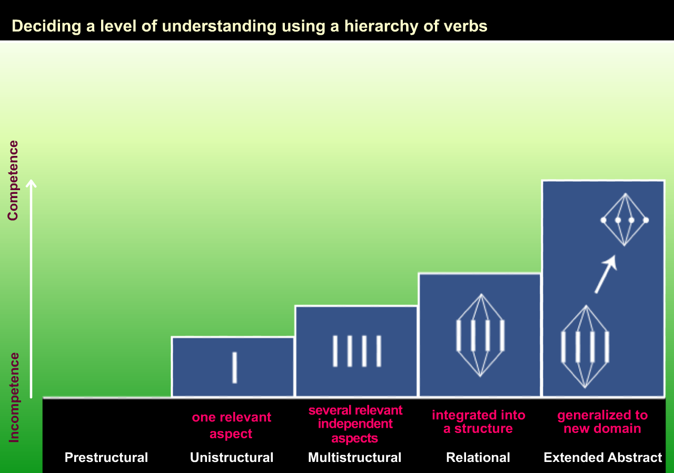
The SOLO* Taxonomy: Action verbs
Create
Formulate
Generate
Hypothesize
Reflect
Theorize
Analyze
Apply
Argue
Compare / Contrast
Criticize
Explain causes
Relate
Justify
Classify
Combine
Describe
Do algorithms
List
Do simple procedures
Define
Identify
Name
Recite
Fail
Incompetent
Misses points
*SOLO: Structure of Observed Learning Outcomes

Slide 10
CHAT: Can you think of ILOs?
Choose a topic of a teaching demonstration (you will do such a teaching demonstration at the end of the term)
Write down 1 ILO using the SOLO taxonomy action verbs.
Enter with Chat
Example:
Upon completion of the course students will be able to:
Identify 10 major contemporary authors
Compare and contrast the literary style of each of those authors
Analyze the effects of the authors’ personal histories on their literary output
Notes:
Chat

Slide 11

Teaching and Learning Activities

Slide 12
Teaching and Learning Activities
These are simply any activity which stimulates, encourages or facilitates learning of one or more Intended Learning Outcomes
It is important to ensure that the TLA is appropriate for the ILO and any subsequent Assessment Tasks.
They can be as diverse as lectures, role play, internships, exchanges, discussions …
Can use a particular learning theory to guide the development of the activity – operant learning, social-cognitive, constructivist, etc.
Notes:
The teacher designs a situation in which the student is required to enact the learning activity nominated in the ILO

Slide 13

Examples of TLA’s
Free writing
Concept Map
Create ‘product’
Experiment
Field trips
Group discussion
Group project
Reflective diary
Role Play
Site visits
Think-Pair-Share
Video
Lecture

Slide 14
CHAT: Can you think of others TLAs?

Slide 15
CHAT: Aligning TLAs with ILOS
Look at the ILO you wrote down earlier in CHAT.
Write down a TLA(s) which will help students to achieve the ILOs.
Type your ILO and you TLA together in CHAT
Free writing
Concept Map
Create ‘product’
Experiment
Field trips
Group discussion
Group project
Reflective diary
Role Play
Site visits
Think-Pair-Share
Video
Written essay
Lecture

Slide 16

Assessment Tasks

Slide 17
Formative and Summative Assessment
 | Formative | Summative
Time | During a learning activity/unit | At the conclusion of a learning activity/unit
Goal | To improve learning | To make a decision
Feedback | Return to material/ learning issues | Final judgement
Frame of reference | Always criterion (evaluating all students according to the same criteria) | Sometimes normative (comparing each student against the others) Sometimes criterion (evaluating each student according to the same criteria)

Slide 18
Summative Assessment Tasks
Before designing any Assessment Tasks, an important first step is to decide what performances would represent evidence that a particular learning outcome has been achieved.
A second step is to ensure that there is an alignment between the learning outcome and the evidence.
[The key to achieving alignment mainly rests with the action verbs that we choose which identify what it is a learner can do after successfully completing the Teaching and Learning Activity]
Notes:
Assessment provides evidence on how well each student has achieved the ILOs. Such evidence could be provided by project work, case studies, assignments, examinations, laboratory work and reports
The assessment task should be a means to assess the outcome. Under a holistic, qualitative scheme, a student's performance is judged against qualitative criteria.

Slide 19
Summative Assessment Tasks
Before designing any Assessment Tasks, an important first step is to decide what performances would represent evidence that a particular learning outcome has been achieved.
A second step is to ensure that there is an alignment between the learning outcome and the evidence.
[The key to achieving alignment mainly rests with the action verbs that we choose which identify what it is a learner can do after successfully completing the Teaching and Learning Activity]
Notes:
Assessment provides evidence on how well each student has achieved the ILOs. Such evidence could be provided by project work, case studies, assignments, examinations, laboratory work and reports
The assessment task should be a means to assess the outcome. Under a holistic, qualitative scheme, a student's performance is judged against qualitative criteria.

Slide 20

Summative Assessment Criteria
Student performance in assessment tasks should be judged against a set of clear assessment criteria defining the quality of performance expected of each of the grades.

Slide 21
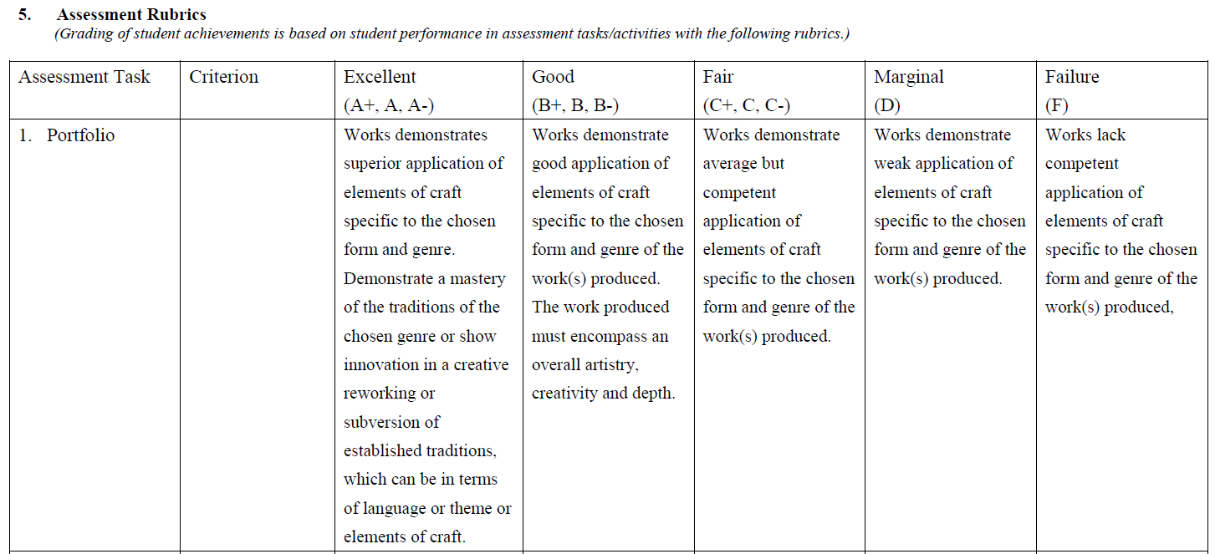
Summative Assessment Criteria: [Example]
Notes:
Assessment provides evidence on how well each student has achieved the ILOs. Such evidence could be provided by project work, case studies, assignments, examinations, laboratory work and reports
The assessment task should be a means to assess the outcome. Under a holistic, qualitative scheme, a student's performance is judged against qualitative criteria.

Slide 22
Assessment Tasks
Look at your ILOs again.
Write down a 1-2 summative assessment tasks that will help you determine if the students have achieved the ILOs.
Be ready to share your answers with the class.
Notes:
Assessment provides evidence on how well each student has achieved the ILOs. Such evidence could be provided by project work, case studies, assignments, examinations, laboratory work and reports
The assessment task should be a means to assess the outcome. Under a holistic, qualitative scheme, a student's performance is judged against qualitative criteria.

Slide 23
Constructive Alignment
An alignment of:
Intended Learning Outcomes
Where you are going?
Teaching and Learning Activities
How are you going to get there?
Assessment Tasks (both as a motivation for learning and a measure of learning effectiveness)
How do you know you are there?
Notes:
The term 'Constructive' relates to theories about how students construct knowledge and is based on the notion of ‘Constructivism’. This is based on the idea that we make sense of the world around us and attribute meaning not through direct instruction or having knowledge imposed upon us, but by our daily interactions with our environment. Adapting to new challenges from our environment forces us to organise our knowledge and formulate new meanings for ourselves. Therefore, our ‘knowledge’ is gradually constructed.
The term 'Alignment' refers to ensuring that our teaching and learning activities and assessment tasks are directly addressing the intended learning outcomes we have chosen for our course/programme.
The three major components of OBTL are clearly and explicitly linked.
At programme level, it can also refer to ensuring that levels of action verbs are addressed in a progressive and logical manner so that students are afforded the opportunity to gradually construct their knowledge of a topic or subject over the three or four years of study.
In OBTL the outcomes that students are intended to attain at the end of a course or programme are the target of teaching, rather than a list of topics the teacher is supposed to 'cover'.
Constructive alignment is a design for implementing OBTL in three stages:
Intended Learning Outcomes (ILOs): These explicitly express the course or programme curriculum in terms of specific outcome knowledge, skills or abilities based on an appropriate action verb. There are usually about five ILO's for each course.
Teaching and Learning Activities (TLAs): Providing and engaging students in a range of learning activities that are designed to provide them with the opportunity to achieve the stated outcomes.
Assessment Tasks (ATs): Assessing how well students have attained those outcomes and converting the results into a final grade for the course.

Slide 24

Final Activity
Review the Slides:
Write ILOs for this SG8001 session
Align it with the TLAs used
Identify the AT used

